Slide 1

GRAPH THEORY, APPLICATIONS AND COMBINATORICS
Surabhi Narayan
Department of Computer Science & Engineering

Slide 2

GRAPH THEORY, APPLICATIONS AND COMBINATORICS
Graph Coloring
Surabhi Narayan
Department of Computer Science & Engineering

Slide 3
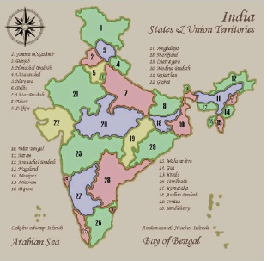
Graph Theory, Applications and Combinatorics
Graph Coloring
Graph Coloring Problem
Given a graph, color all the vertices so that two adjacent vertices get different colors.
Graph Coloring is an assignment of colors (or any distinct marks) to the vertices of a graph. Strictly speaking, a coloring is a proper coloring if no two adjacent vertices have the same color.

Slide 4
Graph Theory, Applications and Combinatorics
Graph Coloring
Definition: A graph has been Properly colored if a color has been assigned to each vertex in such a way that adjacent vertices have different colors.
Definition: The chromatic number of a graph is the smallest number of colors with which it can be colored.
In the example above, the chromatic number is 4.

Slide 5
An application of graph coloring in scheduling
Graph Theory, Applications and Combinatorics
Graph Coloring
Twelve faculty members in a mathematics department serve on the following committees:
Undergraduate education: Sineman, Limitson, Axiomus, Functionini
Graduate Education: Graphian, Vectorades, Functionini, Infinitescu
Colloquium: Lemmeau, Randomov, Proofizaki
Library: Van Sum, Sineman, Lemmeau
Staffing: Graphian, Randomov, Vectorades, Limitson
Promotion: Vectorades, Van Sum, Parabolton
The committees must all meet during the first week of classes, but there are only three time slots available. Find a schedule that will allow all faculty members to attend the meetings of all committees on which they serve.

Slide 6
An application of graph coloring in exam scheduling
Graph Theory, Applications and Combinatorics
Graph Coloring
Suppose that in a particular quarter there are students taking each of the following combinations of courses:
Math, English, Biology, Chemistry
Math, English, Computer Science, Geography
Biology, Psychology, Geography, Spanish
Biology, Computer Science, History, French
English, Psychology, Computer Science, History
Psychology, Chemistry, Computer Science, French
Psychology, Geography, History, Spanish
What is the minimum number of examination periods required for the exams in the ten courses specified so that students taking any of the given combinations of courses have no conflicts? Find a schedule that uses this minimum number of periods.

Slide 7
An application of graph coloring in exam scheduling
Graph Theory, Applications and Combinatorics
Graph Coloring
8.02
6.042
18.02
assign
times:
M 9am
M 1pm
T 9am
T 1pm
3.091
4 time slots
(best possible)
6.001

Slide 8
Graph Theory, Applications and Combinatorics
Graph Coloring
flights need gates, but times overlap.
how many gates needed?
time
122
145
67
257
306
99
Flight Gates
Flights

Slide 9
Graph Theory, Applications and Combinatorics
Graph Coloring
Coloring the Vertices
257
122
145
assign
gates:
67
306
257, 67
122,145
99
306
4 colors
4 gates
99

Slide 10
Graph Theory, Applications and Combinatorics
Graph Coloring
Better Coloring
257
122
145
67
306
3 colors
3 gates
99

Slide 11
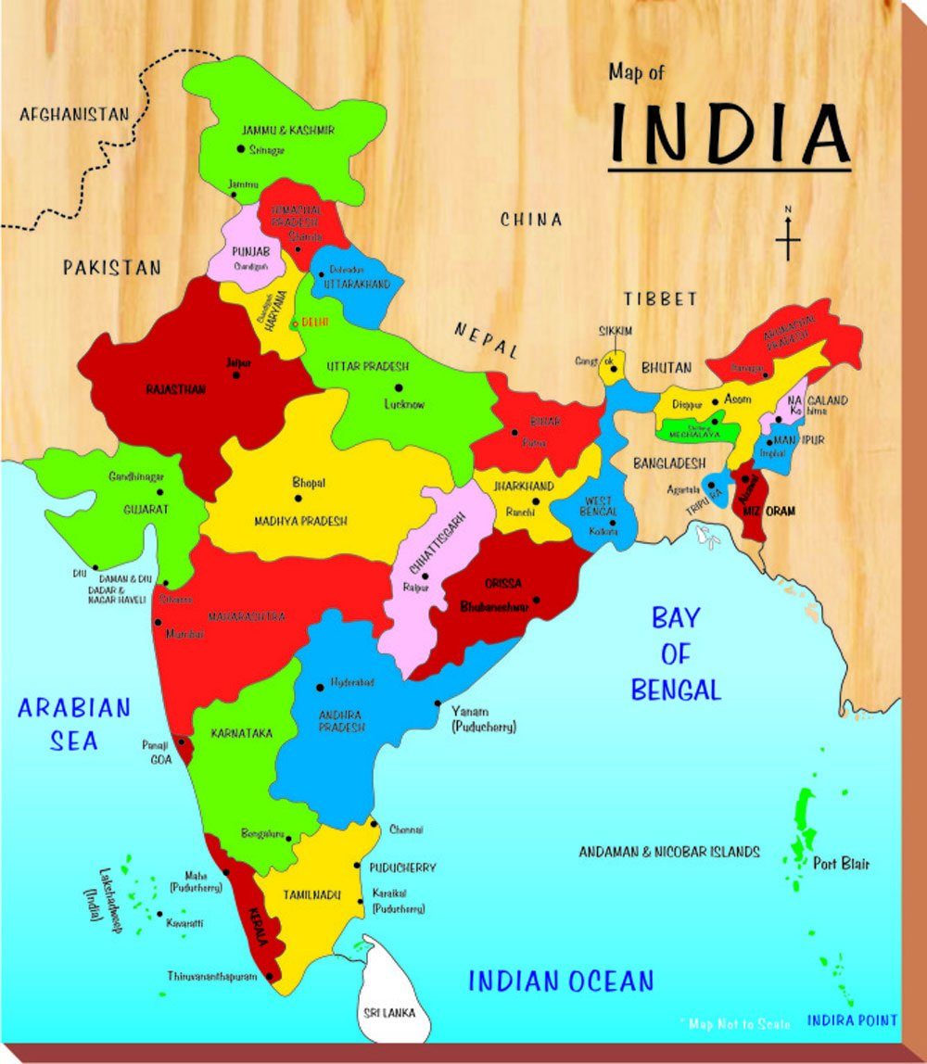
Graph Theory, Applications and Combinatorics
Graph Coloring
Map Coloring
Color the map using minimum number of colors so that two states/countries sharing a border are assigned different colors.

Slide 12
Graph Theory, Applications and Combinatorics
Graph Coloring
Planar Graphs
- Each vertex is a region.
- Two regions have an edge
if they are adjacent.
This is a planar graph.
A graph is planar if there is a way to draw it in the plane without edges crossing.

Slide 13
Graph Theory, Applications and Combinatorics
Graph Coloring
Map Coloring
Can we draw a map so that there are 5 countries
such that any two of which are adjacent?
NO
Can we draw a map which need 5 colours?
NO
Conjecture (1852) Every map is 4-colourable.

Slide 14
Graph Theory, Applications and Combinatorics
Graph Coloring
Planar Graphs
Can we draw a map so that there are 5 countries
such that any two of which are adjacent?
NO

Slide 15
Graph Theory, Applications and Combinatorics
Graph Coloring
Applications of Graph Coloring
Making Schedule or Time Table
Mobile Radio Frequency Assignment: When frequencies are assigned to towers, frequencies assigned to all towers at the same location must be different
Sudoku: Sudoku is also a variation of Graph coloring problem where every cell represents a vertex. There is an edge between two vertices if they are in same row or same column or same block.
Register Allocation:In compiler optimization, register allocation is the process of assigning a large number of target program variables onto a small number of CPU registers. This problem is also a graph coloring problem.
Bipartite Graphs: We can check if a graph is Bipartite or not by coloring the graph using two colors. If a given graph is 2-colorable, then it is Bipartite, otherwise not.
Map Coloring

Slide 16
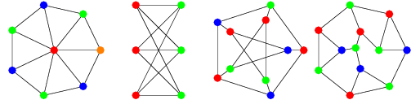
Vertex Coloring
Graph Theory, Applications and Combinatorics
Graph Coloring
A vertex coloring is an assignment of labels or colors to each vertex of a graph such that no edge connects two identically colored vertices

Slide 17
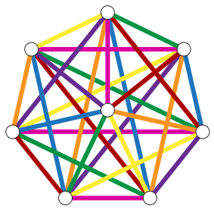
Edge Coloring
Graph Theory, Applications and Combinatorics
Graph Coloring
Similar to vertex coloring, except edges are color.
Adjacent edges have different colors.

Slide 18
Edge Coloring
Graph Theory, Applications and Combinatorics
Graph Coloring
Every edge-coloring problem can be transformed into a vertex-coloring problem
Coloring the edges of graph G is the same as coloring the vertices in L(G)
Not every vertex-coloring problem can be transformed to an edge-coloring problem

Slide 19
Graph Theory, Applications and Combinatorics
Graph Coloring
K-colorable
A graph G is k-colorable if it has a k-coloring.
Chromatic Number
The smallest integer k for which G is k-colorable is called the chromatic number of G, is denoted by the χ(G).

Slide 20
Graph Theory, Applications and Combinatorics
Graph Coloring
Find the chromatic number of the following graphs

Slide 21
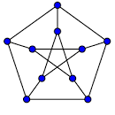
Graph Theory, Applications and Combinatorics
Graph Coloring
Find the chromatic number of the following graphs

Slide 22
Graph Theory, Applications and Combinatorics
Graph Coloring
Observations
A graph consisting of only isolated vertices is 1- chromatic.
A graph with one or more edges is atleast 2-chromatic.
If G is a graph of n vertices then χ(G) <= n
χ(Kn) = n for all n>=1
If a graph G contains a graph G1 as subgraph, then χ(G) >= χ(G1)
If a graph G contains Kn as a subgraph, then χ(G)>= n

Slide 23
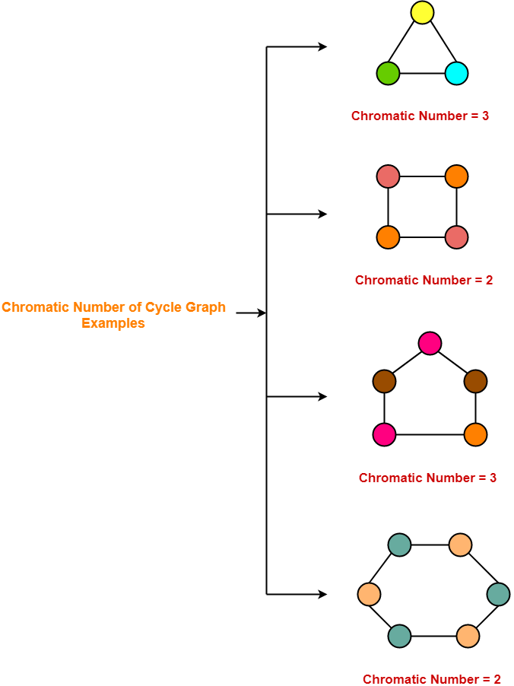
Graph Theory, Applications and Combinatorics
Graph Coloring
Chromatic Number of some common types of graphs
Cycle Graph
A simple graph of ‘n’ vertices (n>=3) and ‘n’ edges forming a cycle of length ‘n’ is called as a cycle graph.
In a cycle graph, all the vertices are of degree 2.
If number of vertices in cycle graph is even, then its chromatic number = 2.
If number of vertices in cycle graph is odd, then its chromatic number = 3.

Slide 24
Graph Theory, Applications and Combinatorics
Graph Coloring
Prove that a graph of order n>=2 consisting of a single cycle is 2-chromatic if n is even and 3-chromatic if n is odd.
Proof: This cycle cannot be 1-chromatic
Assign 2 colors alternatively to the vertices.
Odd numbered vertices: color1
Even numbered vertices: color2.
n is even : properly colored
n is odd: Vn should be colored with color3
v1
Vn
v2
v3

Slide 25
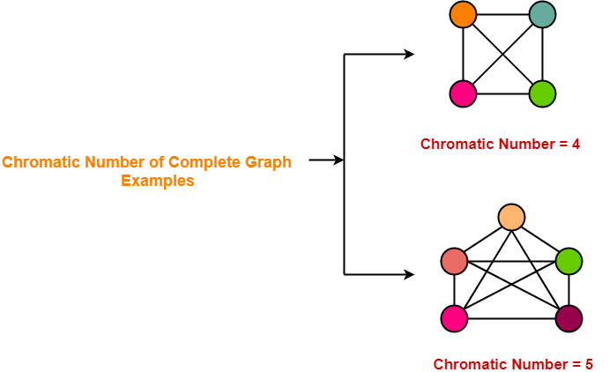
Graph Theory, Applications and Combinatorics
Graph Coloring
Chromatic Number of some common types of graphs
Complete Graphs
A complete graph is a graph in which every two distinct vertices are joined by exactly one edge.
In a complete graph, each vertex is connected with every other vertex.
So to properly it, as many different colors are needed as there are number of vertices in the given graph.

Slide 26
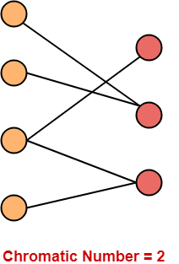
Graph Theory, Applications and Combinatorics
Graph Coloring
Chromatic Number of some common types of graphs
Bipartite Graphs
A Bipartite Graph consists of two sets of vertices X and Y.
The edges only join vertices in X to vertices in Y, not vertices within a set.
Chromatic Number of any Bipartite Graph = 2

Slide 27
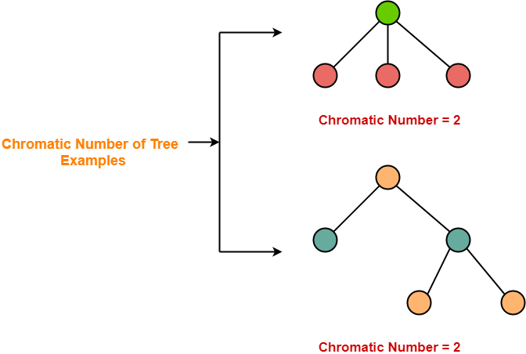
Graph Theory, Applications and Combinatorics
Graph Coloring
Chromatic Number of some common types of graphs
Trees
A Tree is a special type of connected graph in which there are no circuits.
Every tree is a bipartite graph.
So, chromatic number of a tree with any number of vertices = 2.

Slide 28
Graph Theory, Applications and Combinatorics
Graph Coloring
Theorem: Every Tree with two or more vertices is 2-chromatic
Proof:
Select any vertex v to be the root of the tree T.
v: assign color1
Vertices adjacent to v: color2
Vertices adjacent to vertices(color2): color1
Only one path between any two vertices

Slide 29
Graph Theory, Applications and Combinatorics
Graph Coloring
Theorem: A graph with atleast one edge is 2-chromatic if and only if it has no circuits of odd length

Slide 30
Graph Theory, Applications and Combinatorics
Graph Coloring
Graph Coloring Algorithm
There exists no efficient algorithm for coloring a graph with minimum number of colors.
Graph Coloring is a NP complete problem.
However, a following greedy algorithm is known for finding the chromatic number of any given graph.

Slide 31
Graph Theory, Applications and Combinatorics
Graph Coloring
Greedy Algorithm
Color first vertex with the first color.
Now, consider the remaining (V-1) vertices one by one and do the following-
Color the currently picked vertex with the lowest numbered color if it has not been used to color any of its adjacent vertices.
If it has been used, then choose the next least numbered color.
If all the previously used colors have been used, then assign a new color to the currently picked vertex.

Slide 32
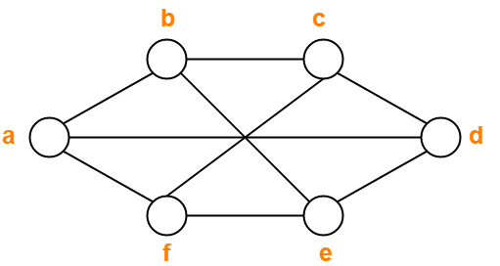
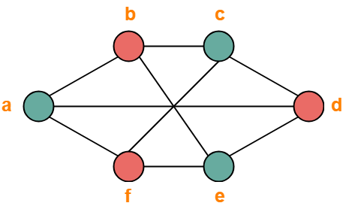
Graph Theory, Applications and Combinatorics
Graph Coloring
Applying Greedy Algorithm, we have-
Vertex | a | b | c | d | e | f
Color | C1 | C2 | C1 | C2 | C1 | C2

Slide 33
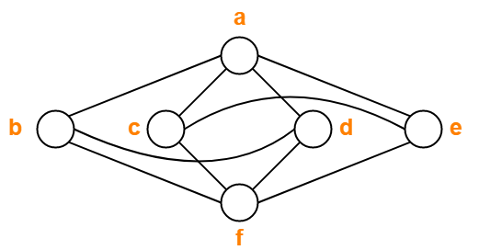
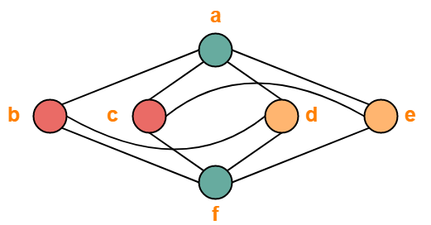
Graph Theory, Applications and Combinatorics
Graph Coloring
Applying Greedy Algorithm, we have-
Vertex | a | b | c | d | e | f
Color | C1 | C2 | C2 | C3 | C3 | C1

Slide 34
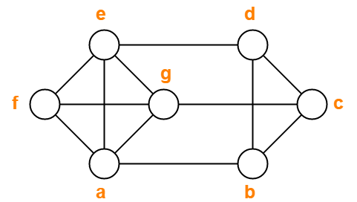
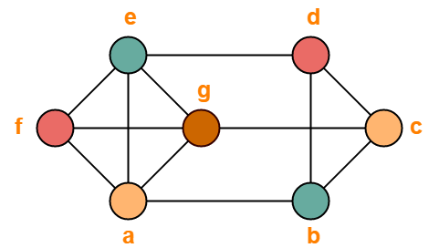
Graph Theory, Applications and Combinatorics
Graph Coloring
Applying Greedy Algorithm, we have-
Vertex | a | b | c | d | e | f | g
Color | C1 | C2 | C1 | C3 | C2 | C3 | C4

Slide 35
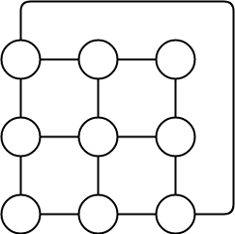
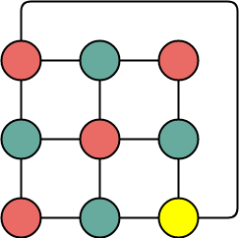
Graph Theory, Applications and Combinatorics
Graph Coloring

Slide 36
Graph Theory, Applications and Combinatorics
Graph Coloring
Drawbacks of Greedy Algorithm
There are following drawbacks of the above Greedy Algorithm
The above algorithm does not always use minimum number of colors.
The number of colors used sometimes depend on the order in which the vertices are processed.

Slide 37
Graph Theory, Applications and Combinatorics
Graph Coloring
Drawbacks of Greedy Algorithm
v2
v3
v1
v4
v5
V1, V2, V3, V4, V5
V5, V4, V3, V2, V1

Slide 38
Graph Theory, Applications and Combinatorics
Graph Coloring
Welsh Powell Graph coloring Algorithm
Find the degree of each vertex
List the vertices in order of descending degrees.
Color the first vertex with color 1.
Move down the list and color all the vertices not connected to the colored vertex, with the same color.
Repeat step 4 on all uncolored vertices with a new color, in descending order of degrees until all the vertices are colored.

Slide 39
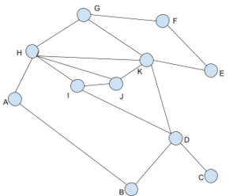
Graph Theory, Applications and Combinatorics
Graph Coloring
Vertex | Degree
A | 2
B | 2
C | 1
D | 4
E | 2
F | 2
G | 3
H | 5
I | 3
J | 3
K | 5
First, order the list in descending order of degrees. Incase of tie, we can randomly choose any ways to break it. So, the new order will be : H, K, D, G, I, J, A, B, E, F, C

Slide 40
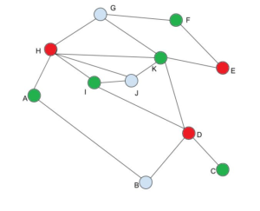
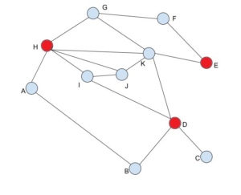
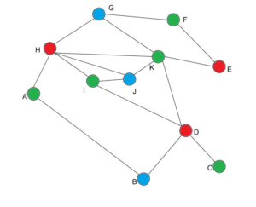
Graph Theory, Applications and Combinatorics
Graph Coloring
H, K, D, G, I, J, A, B, E, F, C

Slide 41
Graph Theory, Applications and Combinatorics
Graph Coloring
Apply Welsh Powell Algorithm to color the graph

Slide 42
Graph Theory, Applications and Combinatorics
Graph Coloring
Apply Welsh Powell Algorithm to color the graph

Slide 43
Graph Theory, Applications and Combinatorics
Graph Coloring
Apply Welsh Powell Algorithm to color the graph

Slide 44
THANK YOU
Surabhi Narayan
Department of Computer Science &Engineering
surabhinarayan@pes.edu

